Slide 1
Intent and Android Components
Jianjun.Chen@xjtlu.edu.cn

Slide 2
Contents
Intent
Services
Broadcast
Context

Slide 3
Android App Components
App components are the essential building blocks of an Android app.
Each component is an entry point through which the system or a user can enter your app.
There are four types of app components:
Activities: Designed for interacting with users.
Services: Keeps an app running in the background.
Broadcast receivers: Allows your app awake and respond to system events.
Content providers: Allows sharing of various kinds data between apps.
In the slides today, the word “component” specifically means one of the above 4.
Notes:
Read here: https://developer.android.com/guide/components/fundamentals

Slide 4

Intent
Explicit, Implicit, Intent-filter

Slide 5
Intent
An intent is an abstract description of an operation to be performed.
Used to facilitate communications between app components
Starting an activity: startActivity(Intent intent, …)
Starting a service startService(Intent service, …) bindService(Intent service, …)
Broadcasting sendBroadcast(Intent intent, …)

Slide 6
Types of Intents
Explicit intents:
“Specify which application will satisfy the intent, by supplying either the target app's package name or a fully-qualified component class name.”
Implicit intents:
Declare a general action to perform.
Android system finds the appropriate component by matching this implicit intent to intent filters.
Intent intent = new Intent(Activity1.this, Activity2.class);
https://stackoverflow.com/questions/14658469/android-intent-context-confusing
Intent launchIntent = getPackageManager().getLaunchIntentForPackage("com.example.abc"); startActivity(launchIntent);

Slide 7
Properties of an Intent
To support implicit and explicit intents, 6 properties are defined.
Properties used in implicit intents:
Action
Data
Category
Type
Properties used in explicit intents:
Component
For passing data
Extras (Bundle)

Slide 8
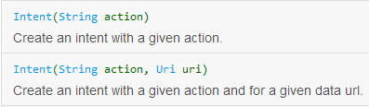
Intent: Action
The Action in an Intent is simply a string.
You can set the action of an intent using
intent.setAction(String)
Intent constructors also allow you to set actions.
Android has its own set of standard actions defined inside the Intent class.
ACTION_MAIN, ACTION_VIEW …
Check the API document for intent.

Slide 9
Intent: Data
Data is a uniform resource identifier (URI). URI is a formatted piece of text that is an immutable one-to-one mapping to a resource or data.
<scheme>://<host>:<port>/<path>
For example, the URI of a contact with identifier 1 is content://contacts/1
ftp://ftp.is.co.za/rfc/rfc1808.txt
mailto:someone@example.com
It makes more sense if you combine data and action together:
ACTION_VIEW content://contacts/people/1
This asks android to display information about the person whose identifier is "1".

Slide 10
Intent: Data
To set the data of an intent, use:
intent.setData(Uri data)
To get a Uri object of something, use
Uri.parse()
For example:
Read More https://developer.android.com/reference/android/net/Uri.
Intent intent = new Intent(Intent.ACTION_DIAL); intent.setData(Uri.parse("tel:1771778888")); startActivity(intent);

Slide 11
Intent: Type
This property provides the data type (MIME) enforcement to the target.
Such as what kind of files I want to open in the file browser
A MIME type is a string indicating the type of a file:
An mp3 audio file is labelled “audio/mp3”.
An image can be labelled as “image/png” or “image/jpeg”
Specifying the MIME type of your data helps the Android system find the best component to receive your intent.

Slide 12
Intent: Type
To set MIME data type of an Intent:
intent.setType(String)
This will unset any data that was previously set.
setData() also nullifies setType().
You can set both data and type by calling:
setDataAndType(Uri data, String type)

Slide 13
Intent: Category
A string containing additional information about the kind of component that should handle the intent.
To set the category of an intent:
intent.addCategory("CATEGORY_NAME");
You can add multiple categories to an intent.

Slide 14
Intent: Component
Specifies an explicit name of a component class to use for the intent.
ImageShow.class is the component.
You can also set the component using setComponent().
Intent i2 = new Intent(getApplicationContext(), ImageShow.class); startActivity(i2);
Intent startApp = new Intent(); startApp.setComponent(new
ComponentName("cn.edu.xjtlu.broadcasttestreceiver",
"cn.edu.xjtlu.broadcasttestreceiver.MainActivity")); startActivity(startApp);
Target App’s package name
class name

Slide 15
Intent: Extras
This is a Bundle of any additional information. Extras can be used to provide extended information to the component.
Check our previous slides if you have no idea what a Bundle is.

Slide 16

Intent Resolution
Intent filters, Matching Process

Slide 17
Implicit Intent & Intent Filters
To be able to receive implicit intent requests, the target component must first register itself in the Android System.
Activity, service, broadcast receiver can all have intent filters.
Done by defining intent filter blocks in the manifest XML.
<activity android:name=".IntentTest"> <intent-filter> <action android:name="android.intent.action.MAIN" /> <category android:name="android.intent.category.LAUNCHER" /> </intent-filter> </activity> <activity android:name=".ImageShow"> <intent-filter> <action android:name="cn.edu.xjtlu.TestApp.SHOW_SLUG" /> <category android:name="android.intent.category.DEFAULT" /> </intent-filter> </activity>
Notes:
https://developer.android.google.cn/guide/components/intents-filters?hl=en

Slide 18
Intent Filter Blocks
Each <intent-filter> block can have several action, data and category components defined.
If a component is designed to receive multiple types of intents, it will need several <intent-filter> blocks.
To successfully send an intent to a component, the intent will be must pass the action, type and category check of any filter block of that component.
Intent-filter
<action android:name=…>
<data …>
<category android: name=…>
intent
intent action
intent MIME type and Data
intent category

Slide 19

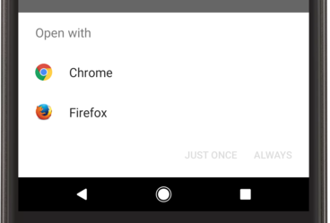
Intent Resolution
Once an app is installed, all of its intent filter blocks of will be registered in the system.
When an Intent is sent, it will be compared against all registered intent-filter blocks and launch the matching one
If the system identifies more than one activity that can handle the intent, it displays the disambiguation dialog.
Intent filters of Activity
intent filter 1 | Action1 | Type1 | Category1
intent filter 2 | Action2 | Type2 | Category2
intent filter 3 | Action3 | Type3 | Category3
Intent
Action1 | Type1 | Category1

Slide 20
Intent Resolution: Action & Category
Action:
<action android:name="action_name" />
The action specified in the Intent must match one of the action block inside the filter to pass the test.
An intent filter with zero action declared will never receive any intent.
Category:
<category android:name="category_name" />
Every category in the Intent must match a category in the filter. The reverse is not necessary.
An intent with zero category will always pass the test.
An intent with categories A, B matches a filter with categories A, B, C.

Slide 21
The Default Category
Android automatically applies the CATEGORY_DEFAULT category to all implicit intents passed to startActivity() and startActivityForResult().
An activity’s category should always have android.intent.category.DEFAULT in its intent filter.

Slide 22
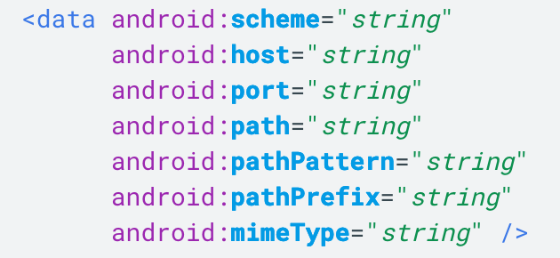
Intent Resolution: Data & Data Test
<data> element:
Data test compares both the URI and the MIME type in the intent to a URI and MIME type specified in the filter.
Read More:
https://developer.android.com/guide/topics/manifest/data-element
https://developer.android.com/guide/components/intents-filters#DataTest
<scheme>://<host>:<port>[<path>|<pathPrefix>|<pathPattern>]

Slide 23
Intent Resolution: Some Examples
The code below tries to start the calculator in the system.
works on the Xiaomi tablet, but not on AVD android systems.
The code below opens our university’s homepage
Read more: https://developer.android.google.cn/guide/components/intents-common?hl=en
Intent intent = new Intent(); intent.setAction(Intent.ACTION_MAIN); intent.addCategory(Intent.CATEGORY_APP_CALCULATOR); intent.setFlags(Intent.FLAG_ACTIVITY_NEW_TASK); startActivity(intent);
Uri webpage = Uri.parse("https://www.xjtlu.edu.cn"); Intent intent = new Intent(Intent.ACTION_VIEW, webpage); if (intent.resolveActivity(getPackageManager()) != null) { startActivity(intent); }
Checks whether a component can handle this request

Slide 24
Intent Resolution: Customized Filters
How to define and use your own intent filters?
They are just string values:
Intent intent = new Intent(); intent.setAction("hello_hello_helloooo"); startActivity(intent);
<activity android:name=".MainActivity2" android:label="@string/title_activity_main2" android:theme="@style/AppTheme.NoActionBar"> <intent-filter> <action android:name="hello_hello_helloooo" /> <category android:name="android.intent.category.DEFAULT" /> </intent-filter> </activity>

Slide 25
Intent Resolution: Example 4
static final int REQUEST_IMAGE_GET = 1; public void selectImage() { Intent intent = new Intent(Intent.ACTION_GET_CONTENT); intent.setType("image/*"); if (intent.resolveActivity(getPackageManager()) != null) { startActivityForResult(intent, REQUEST_IMAGE_GET); } } protected void onActivityResult (int requestCode, int resultCode, Intent data) { super.onActivityResult(requestCode, resultCode, data); if (requestCode == REQUEST_IMAGE_GET && resultCode == RESULT_OK) { Bitmap thumbnail = data.getExtras().getParcelable("data"); Uri fullPhotoUri = data.getData(); // Do work with photo saved at fullPhotoUri } }
Notes:
https://stackoverflow.com/questions/13065838/what-are-the-possible-intent-types-for-intent-settypetype
“actually in android, for the mime types you separate with a space, not a comma. Using a comma makes android ignore everything but the first, so to get it to work you should use "image/png image/jpeg"”

Slide 26

Extended Reading
https://developer.android.com/training/basics/intents

Slide 27

Service
startService
bindService

Slide 28



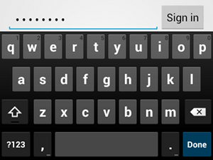
The Service Component
A service is a general-purpose entry point for keeping an app running in the background for all kinds of reasons.
Service can perform a longer-running operation while not interacting with the user
Sync data in the background: Seafile (Box)
Play music (a playlist) in the background: Spotify, QQ Music.
Live wallpaper for home screen.
It can also be used to supply functionality for other applications to use.
InputMethodService

Slide 29
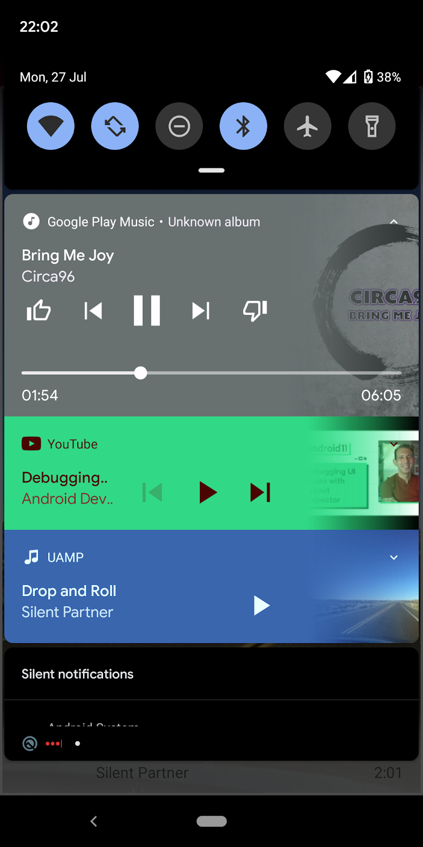
Types of Services
Foreground service: performs some operation that is noticeable to the user.
Foreground service must display a notification.
E.g., Audio app use foreground service to play music.
Background service: performs an operation that isn't directly noticed by the user.
E.g., download some information from the Internet.
Bound service: only started when another app component calls bindService() to bind to this service.
One can create services with mixed features. E.g., a background service that allows other components to bind.
Notes:
https://developer.android.com/guide/components/foreground-services#java

Slide 30
Creating a Service
Create a class that extends android.app.Service.
Override needed call-back functions of Service.
onStartCommand()
onBind()
onCreate()
onDestroy()
Register your class inside AndroidManifest.
<service android:name=".MyService" android:enabled="true"></service>
Class name:
MyService
Notes:
<service android:name=".MyService" android:enabled="true" android:exported="true"></service>

Slide 31
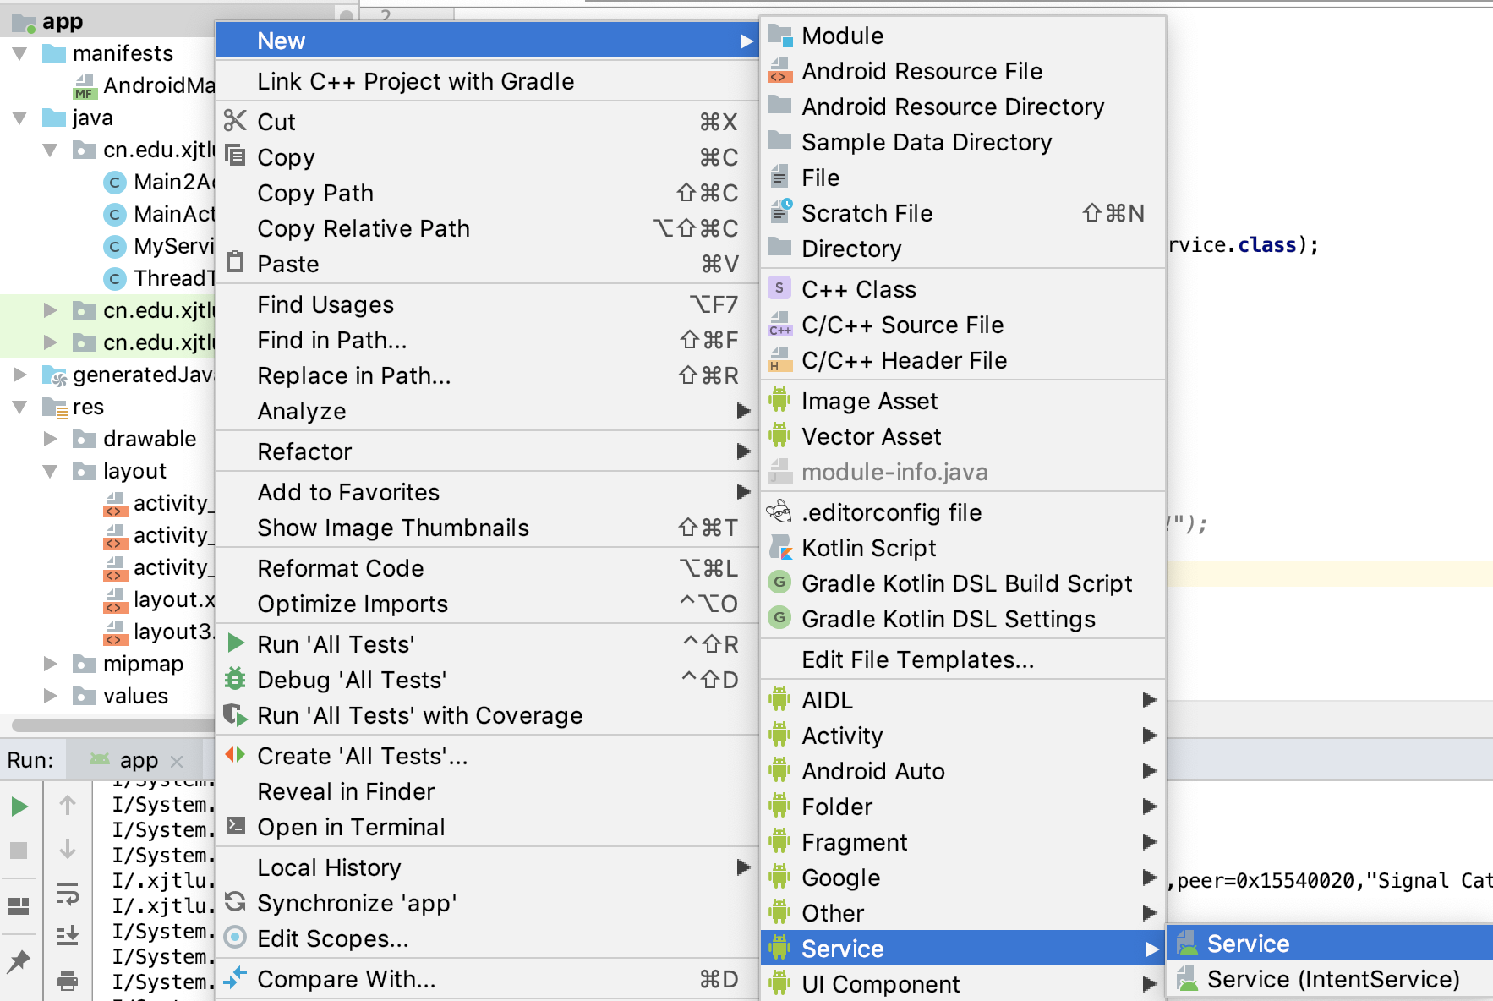

Slide 32
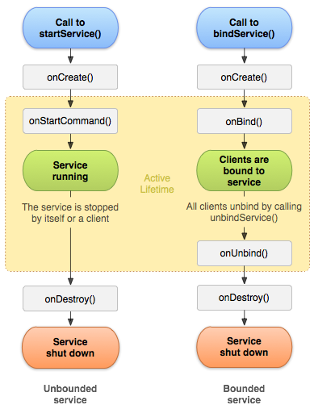
Starting a Service
Context.startService():
This service can run in the background indefinitely, even if the component that started it is destroyed.
Cannot interact with the service once it is started.
Context.bindService():
This service only lives while it serves another component.
If its last component unbinds, the service will be destroyed by the Android System.
Can interact with the service.

Slide 33
Service: Call-backs
All call-back functions run on the UI thread.
onCreate: executed once when this service is created.
onStartCommand: executed if this service is started by startService().
onBind: executed when another component calls bindService().
onDestory: executed when the service is about to stop.

Slide 34
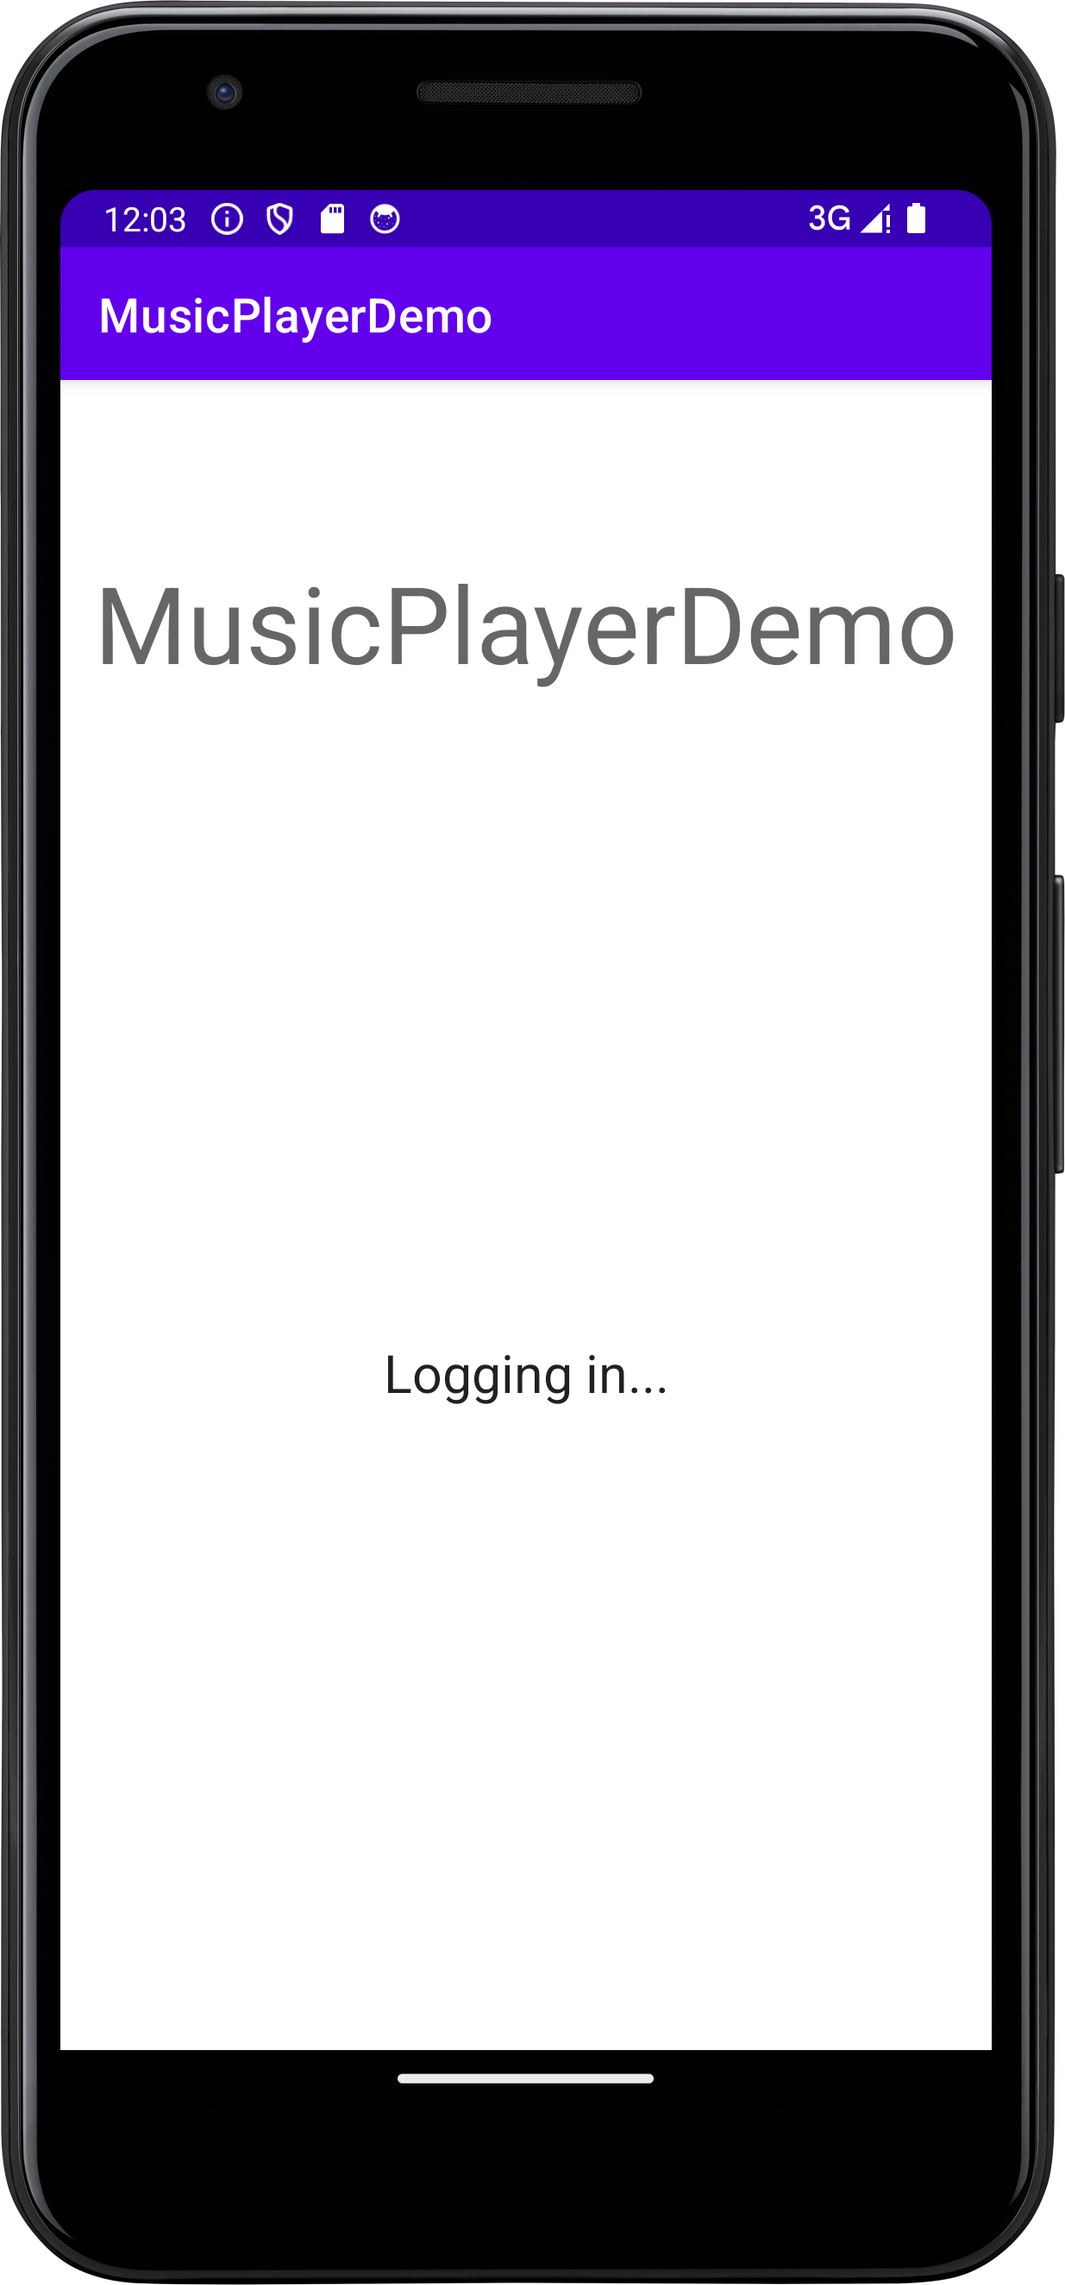
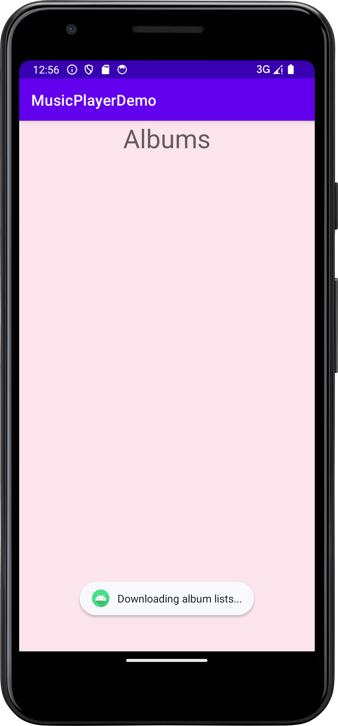
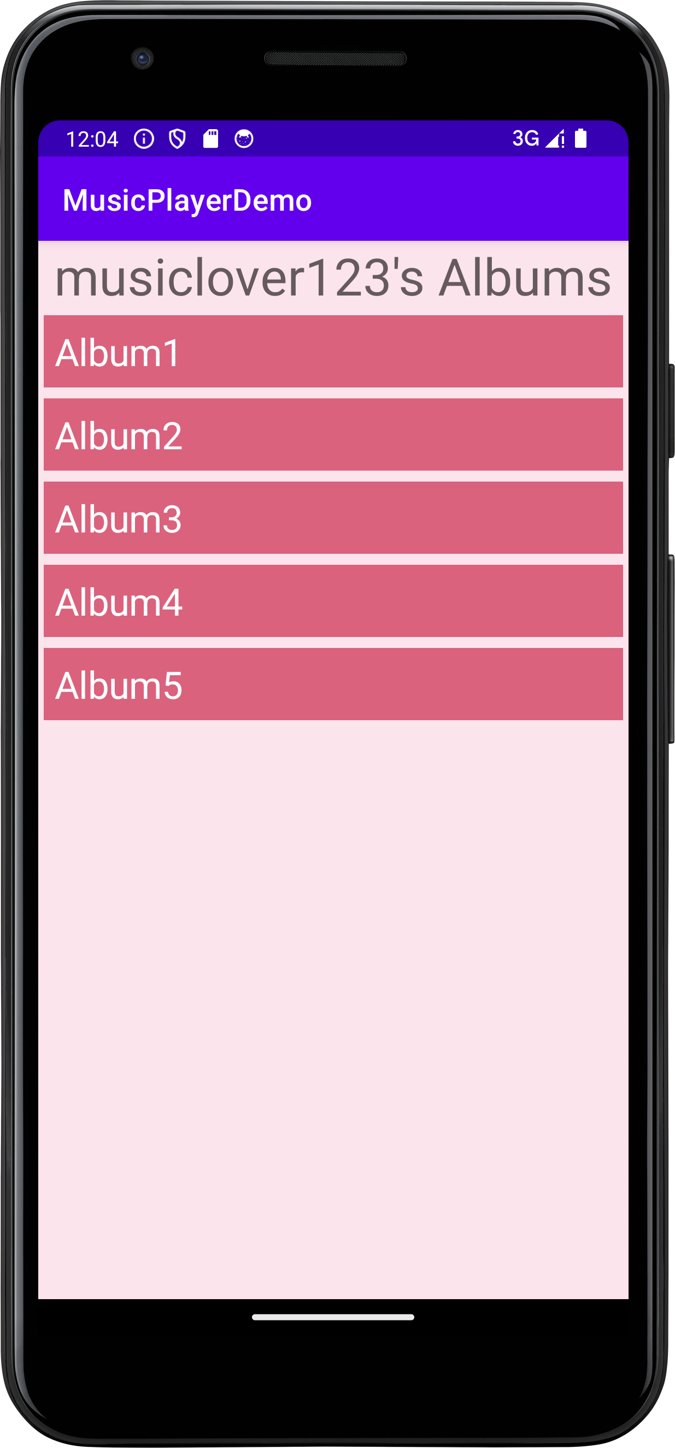
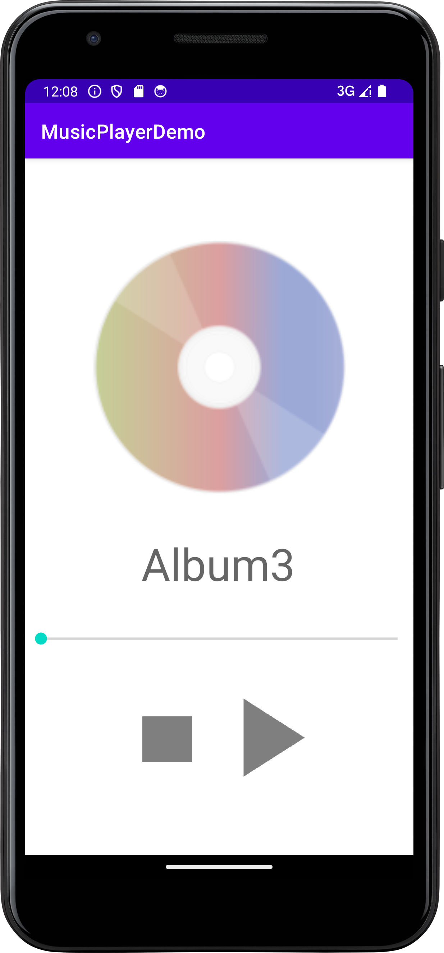
Service Example: MusicPlayerDemo
Use initService to
Download album list
Bind MusicPlayService to play album
GreetingsActivity
AlbumListActivity
AlbumListActivity (albums loaded)
AlbumPlayerActivity

Slide 35
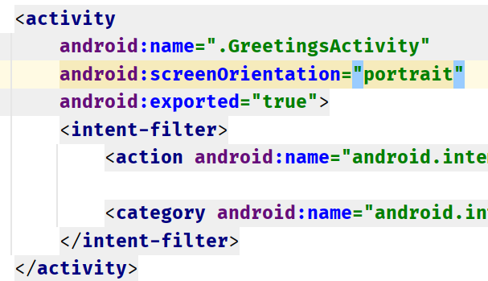
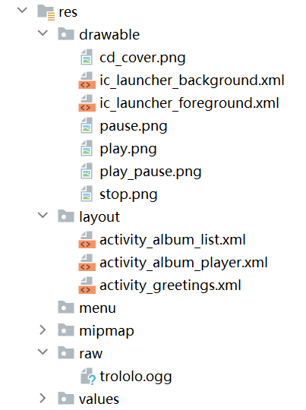
App Basic Settings
We want the app to run in portrait mode.
Solution: Add screenOrientation to all activity sections in Manifest.
The audio file is stored in “res/raw”.
A better place to store audios is app’s external folder (covered in another lecture).
Ideally, the app should download audio files from a server.

Slide 36
① Implementing InitService
Intent intent = new Intent(this, InitService.class); startService(intent);
public class InitService extends Service {
@Override public int onStartCommand(Intent intent, int flags, int startId) { ...... return super.onStartCommand(intent, flags, startId); } @Override public IBinder onBind(Intent intent) { return null; }
...... }
onBind() will not be called when using startService(), but you must implement this abstract method.

Slide 37
Stopping a “Started” Service
A started service can run in the background indefinitely, even if the component that started it is destroyed.
You can manually stop a started service by calling stopService(intent)from outside of the service
Or call stopSelf() inside the Service class.
Intent intent = new Intent(this, MyService.class); startService(intent); stopService(intent);

Slide 38
Service VS Thread
In the previous code, Can we use a thread instead of using service?
Possible, but thread lacks some functionalities.
Service is an app component:
It has life circle functions.
A service is started by using an Intent, it can be started from another app and controlled by an activity from another app via Ibinder.
Service can receive broadcast messages. This allows you to adjust app’s behaviours according to some system events (battery life etc.).
Service run on the UI thread.
Actual work like playing music or downloading should still be done on a thread.
Notes:
https://stackoverflow.com/questions/22933762/service-vs-thread-in-android

Slide 39
② Implementing MediaPlayService
The MediaPlayService will be started using an intent that contains the album name.
The service will use MediaPlayer to load the audio.
The play/stop button controls the MediaPlayer.
albumPlayIntent.putExtra("album_name", …);
MediaPlayer player = MediaPlayer.create(this, R.raw.trololo);
playPauseBtn.setOnClickListener((btn)->{ … if (player.isPlaying()) { player.pause(); playPauseBtn.setImageResource(R.drawable.play); } … });

Slide 40
Bound Service
There are four key components involved with a bound service:
The service itself: We showed how to create a service class earlier
A Binder object, defines the programming interface that clients can use to interact with the service.
The client, another component (e.g. activity) who binds to a service.
An implementation of ServiceConnection for client, which is the interface for monitoring the state of an application service
Client
Service
ServiceConnection
IBinder

Slide 41
Service1 please
Service1
bindService(Intent, ServiceConnection)
IBinder
Client
Android system
ServiceConnection
Service2
IBinder
Service1
Client
Intent
Android system
onBind(Intent) {
return IBinder
}
ServiceConnection
IBinder
Client
ServiceConnection
Android system
IBinder
onServiceConnected(IBinder) {
Use IBinder
}
IBinder

Slide 42
Service and Binder
Create the Service.
Inside the Service, create a Binder that either:
Contains public methods that the client can call.
Returns the current Service instance, which has public methods the client can call.
Or, returns an instance of another class hosted by the service with public methods the client can call.
Return this Binder from the onBind() method.
Do not implement IBinder directly. https://developer.android.com/reference/android/os/IBinder.html

Slide 43
Service and Binder
public class MusicPlayService extends Service { MediaPlayer player; class MusicPlayBinder extends Binder { public MediaPlayer getPlayer() { return MusicPlayService.this.player; } } private IBinder binder = new MusicPlayBinder(); public MusicPlayService() { } @Override public IBinder onBind(Intent intent) { String album = intent.getStringExtra("album_name"); // Ideally, we should play that album. // This demo will always play the same song. player = MediaPlayer.create(this, R.raw.trololo); return binder; } }

Slide 44
Client and ServiceConnection
public class AlbumPlayerActivity extends AppCompatActivity { ServiceConnection mConnection = new ServiceConnection() { @Override public void onServiceConnected(ComponentName name, IBinder service)
{ player = ((MusicPlayService.MusicPlayBinder) service).getPlayer(); } @Override public void onServiceDisconnected(ComponentName name) { player = null; } }; @Override protected void onCreate(Bundle savedInstanceState) {
…
bindService(albumPlayIntent, mConnection, BIND_AUTO_CREATE); } }
“automatically create the service”

Slide 45
SeekBar Progress Control
class SeekCheckerThread extends Thread { @Override public void run() { while(true) { try { Thread.sleep(1000); } catch (InterruptedException e) { throw new RuntimeException(e); } if (seekBar == null || player == null || !player.isPlaying()) { continue; } runOnUiThread(
()->seekBar.setProgress(player.getCurrentPosition())); } } }
This thread is started as soon as the AlbumPlayActivity is shown

Slide 46

Broadcasts
Mechanism and Example

Slide 47
Broadcasts
Android apps can send or receive broadcast messages from the Android system and other Android apps.
Sent through sendBroadcast(intent).
The receiver is BroadcastReceiver.
The registration of the receiver can be done by:
Calling Context.registerReceiver().
Adding <Intent-filter> blocks in the manifest file.

Slide 48
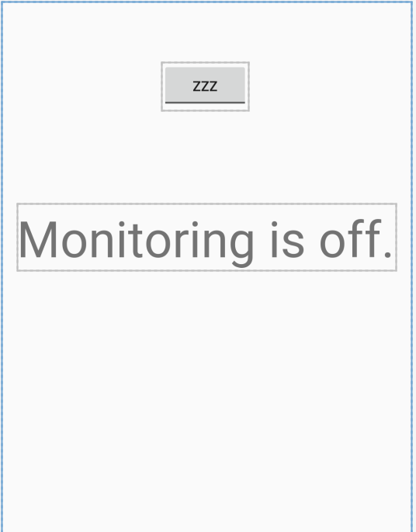
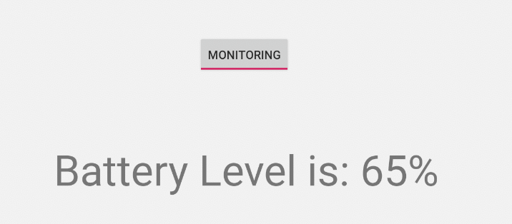
BroadcastReceiver Example
In the next few slides, we aim to create an activity that let the user monitor the battery level of his phone.
A toggle button can switch on/off the monitoring.
Dynamical method will be used.

Slide 49
Step 1: UI
<ToggleButton android:id="@+id/monitorBtn" ...... android:textOn="Monitoring" android:textOff="Zzz" />
<TextView android:id="@+id/BatteryLevelText"
...... android:text="Monitoring is off." android:textSize="50dp" />

Slide 50
Step 2: Activity
public class MonitorMain extends AppCompatActivity { @Override protected void onCreate(Bundle savedInstanceState) { super.onCreate(savedInstanceState); setContentView(R.layout.activity_main); ToggleButton monitorBtn = findViewById(R.id.monitorBtn); final TextView batteryLvl = findViewById(R.id.BatteryLevelText);
...

Slide 51
Step 3: BroadcastReceiver
Still inside onCreate()
final BroadcastReceiver receiver = new BroadcastReceiver() { @Override public void onReceive(Context context, Intent intent) { if (intent.getAction().equals(intent.ACTION_BATTERY_CHANGED)) { int current = intent.getExtras().getInt("level"); int max = intent.getExtras().getInt("scale"); int value = current * 100 / max; batteryLvl.setText("Battery Level is: " + value + "%"); } } };

Slide 52
Step 4: Button Event
Still inside onCreate()
monitorBtn.setOnCheckedChangeListener(new CompoundButton.OnCheckedChangeListener() { @Override public void onCheckedChanged(CompoundButton buttonView,
boolean isChecked) { if (isChecked) { IntentFilter filter =
new IntentFilter(Intent.ACTION_BATTERY_CHANGED); registerReceiver(receiver, filter); } else { unregisterReceiver(receiver); batteryLvl.setText("Back to Zzz"); } } });

Slide 53

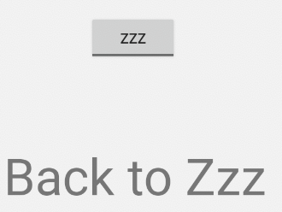
Running and Testing
Change battery level here in AVD

Slide 54
Manifest-declared Receivers
Starting from Android 8.0 (API level 26), the system imposes additional restrictions on manifest-declared receivers.
If your app targets Android 8.0 or higher, you cannot use the manifest to declare a receiver for most implicit broadcasts (broadcasts that don't target your app specifically).
https://developer.android.google.cn/guide/components/broadcasts?hl=en#context-registered-recievers.

Slide 55
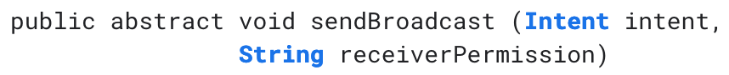
Sending Broadcasts
The Context class provide two methods:
What is the difference? Find it out by yourself
https://developer.android.google.cn/guide/components/broadcasts?hl=en
Optional Param
Notes:
The answer:
The first one sends the broadcast to all receivers, receivers have no control on the propagation of this broadcast.
The second one allows receivers to receive the broadcast one by one like a queue, a receiver can decide whether the broadcast should propagate or not by calling BroadcastReceiver::abortBroadcast()

Slide 56
Extended Reading: Context
getSystemService()

Slide 57
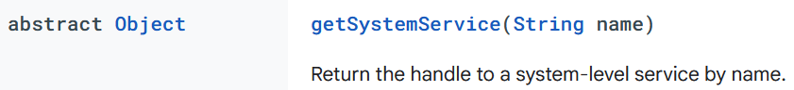
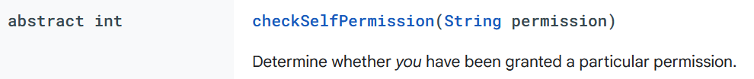
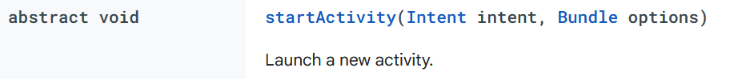
The Context Class
Interface to global information about an application environment.
It allows access to application-specific resources and classes
Whether sensors, GPS unit are available on your device.
Whether certain permissions are granted to app
as well as up-calls for application-level operations such as launching activities, broadcasting and receiving intents, etc.
Notes:
https://stackoverflow.com/questions/10641144/difference-between-getcontext-getapplicationcontext-getbasecontext-and
View.getContext(): Returns the context the view is currently running in. Usually the currently active Activity.
Activity.getApplicationContext(): Returns the context for the entire application (the process all the Activities are running inside of). Use this instead of the current Activity context if you need a context tied to the lifecycle of the entire application, not just the current Activity.
ContextWrapper.getBaseContext(): If you need access to a Context from within another context, you use a ContextWrapper. The Context referred to from inside that ContextWrapper is accessed via getBaseContext().

Slide 58
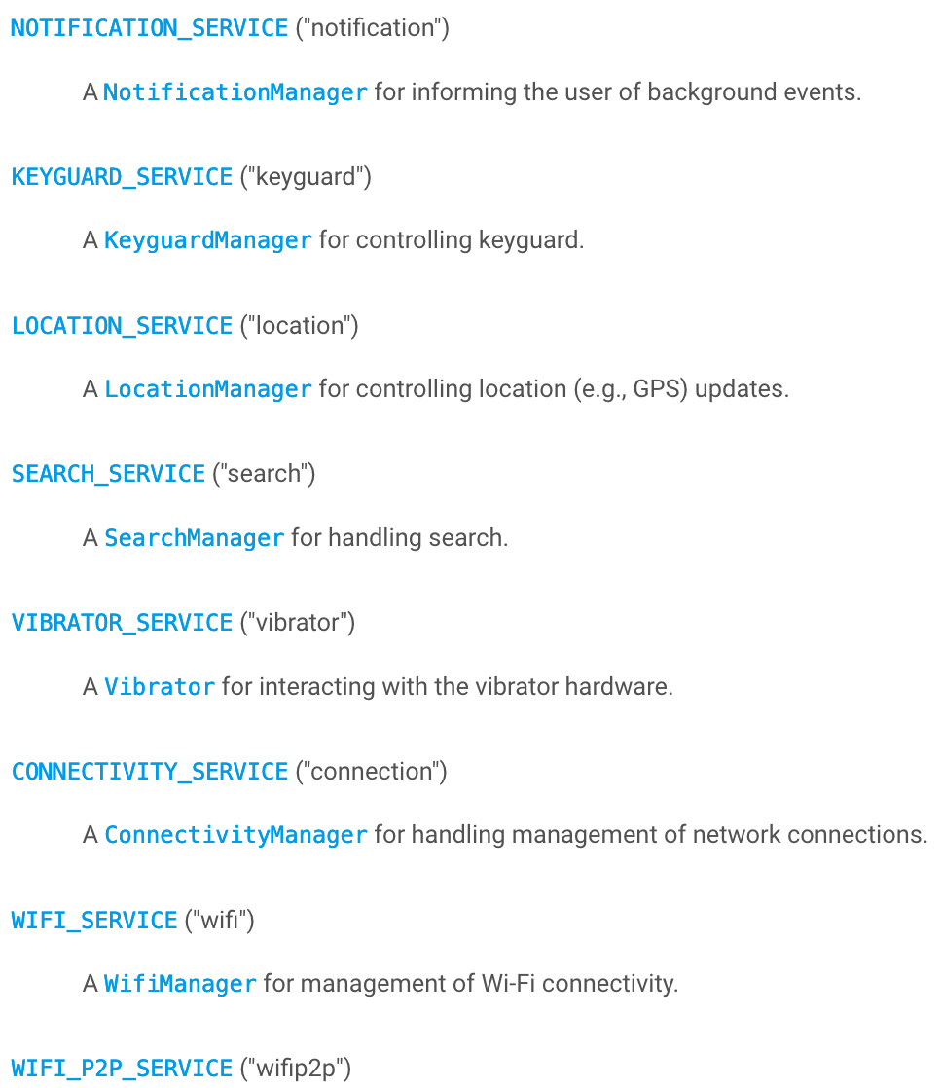
Available in the official android API document

Slide 59
Lab Tasks:
Read about the data check in the intent-filter block.
Read about foreground service, as they are involved with notifications.
Extend the music player demo:
Make the player show a notification when playing albums (foreground service).
True album support: Finds correct audio files when playing a whole album. Please decide the organization of audio files by yourself.
Allow users to select a single song in an album.
Notes:
You will need:
Permission to be a startup app
Receive boot completed intent in the manifest file
Start the activity using context.startActivity() inside onReceive(Context, Intent)

